Slide 1
Weekly meeting 3
Shengya Guo, CR/AVS3, 10.07.2024

Slide 2
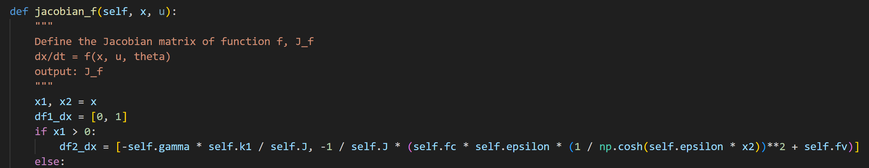
Problem by the simplified EMB model using tanh() function
overflow encountered in cosh() because of big epsilon

Slide 3

Simplified EMB model from Olsson
$$J\ddot{θ}=T_{m}−T_{l}−T_{f}$$
$$T_{m}=k_{m}i_{m}$$
$$T_{l}=γF_{cl}$$
$$F_{cl}=k_{1}θ$$
$$T_{f}= \left\{\begin{aligned}f_{c}\operatorname{sgn}\left(\dot{θ}\right)+f_{v}\dot{θ} if\dot{|θ|}&>ε \\ T_{e} if \dot{|θ|}&<ε and T_{e}<T_{s} \\ T_{s} else\end{aligned}\right.$$
$$T_{s}=1.2\left(f_{c}\operatorname{sgn}\left(ε\right)+f_{v}\left(ε\right)\right)$$
$$ε=0.5 rad/s$$
$$\ddot{θ}= \left\{\begin{aligned}{\frac{1}{J}(k_{m}i_{m}−γk_{1}θ−(f}_{c}\operatorname{sgn}\left(\dot{θ}\right)+f_{v}\dot{θ})) if\dot{|θ|}&>ε \\ 0 if \dot{|θ|}&<ε and T_{e}<T_{s} \\ {\frac{1}{J}(k_{m}i_{m}−γk_{1}θ−T}_{S}) else\end{aligned}\right.$$

Slide 4
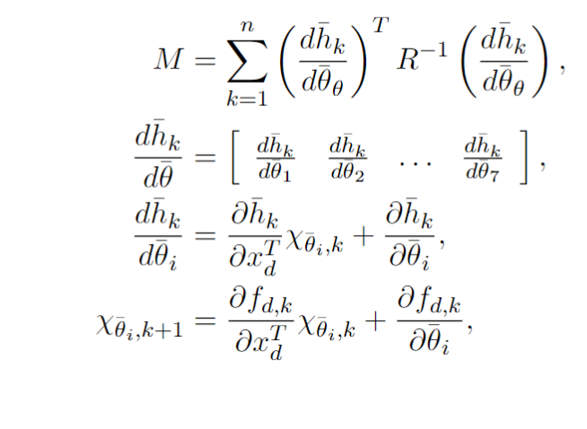
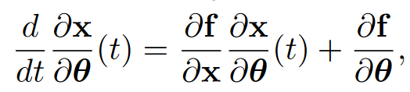
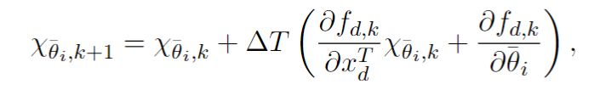
Calculation of the FI matrix

Slide 5
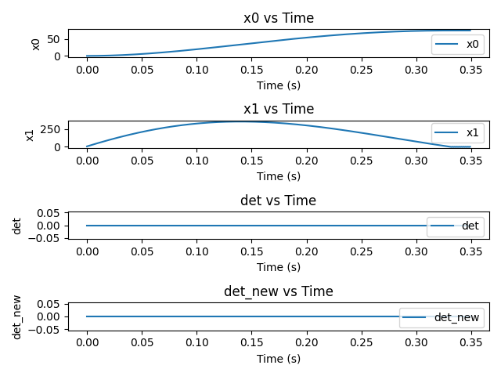
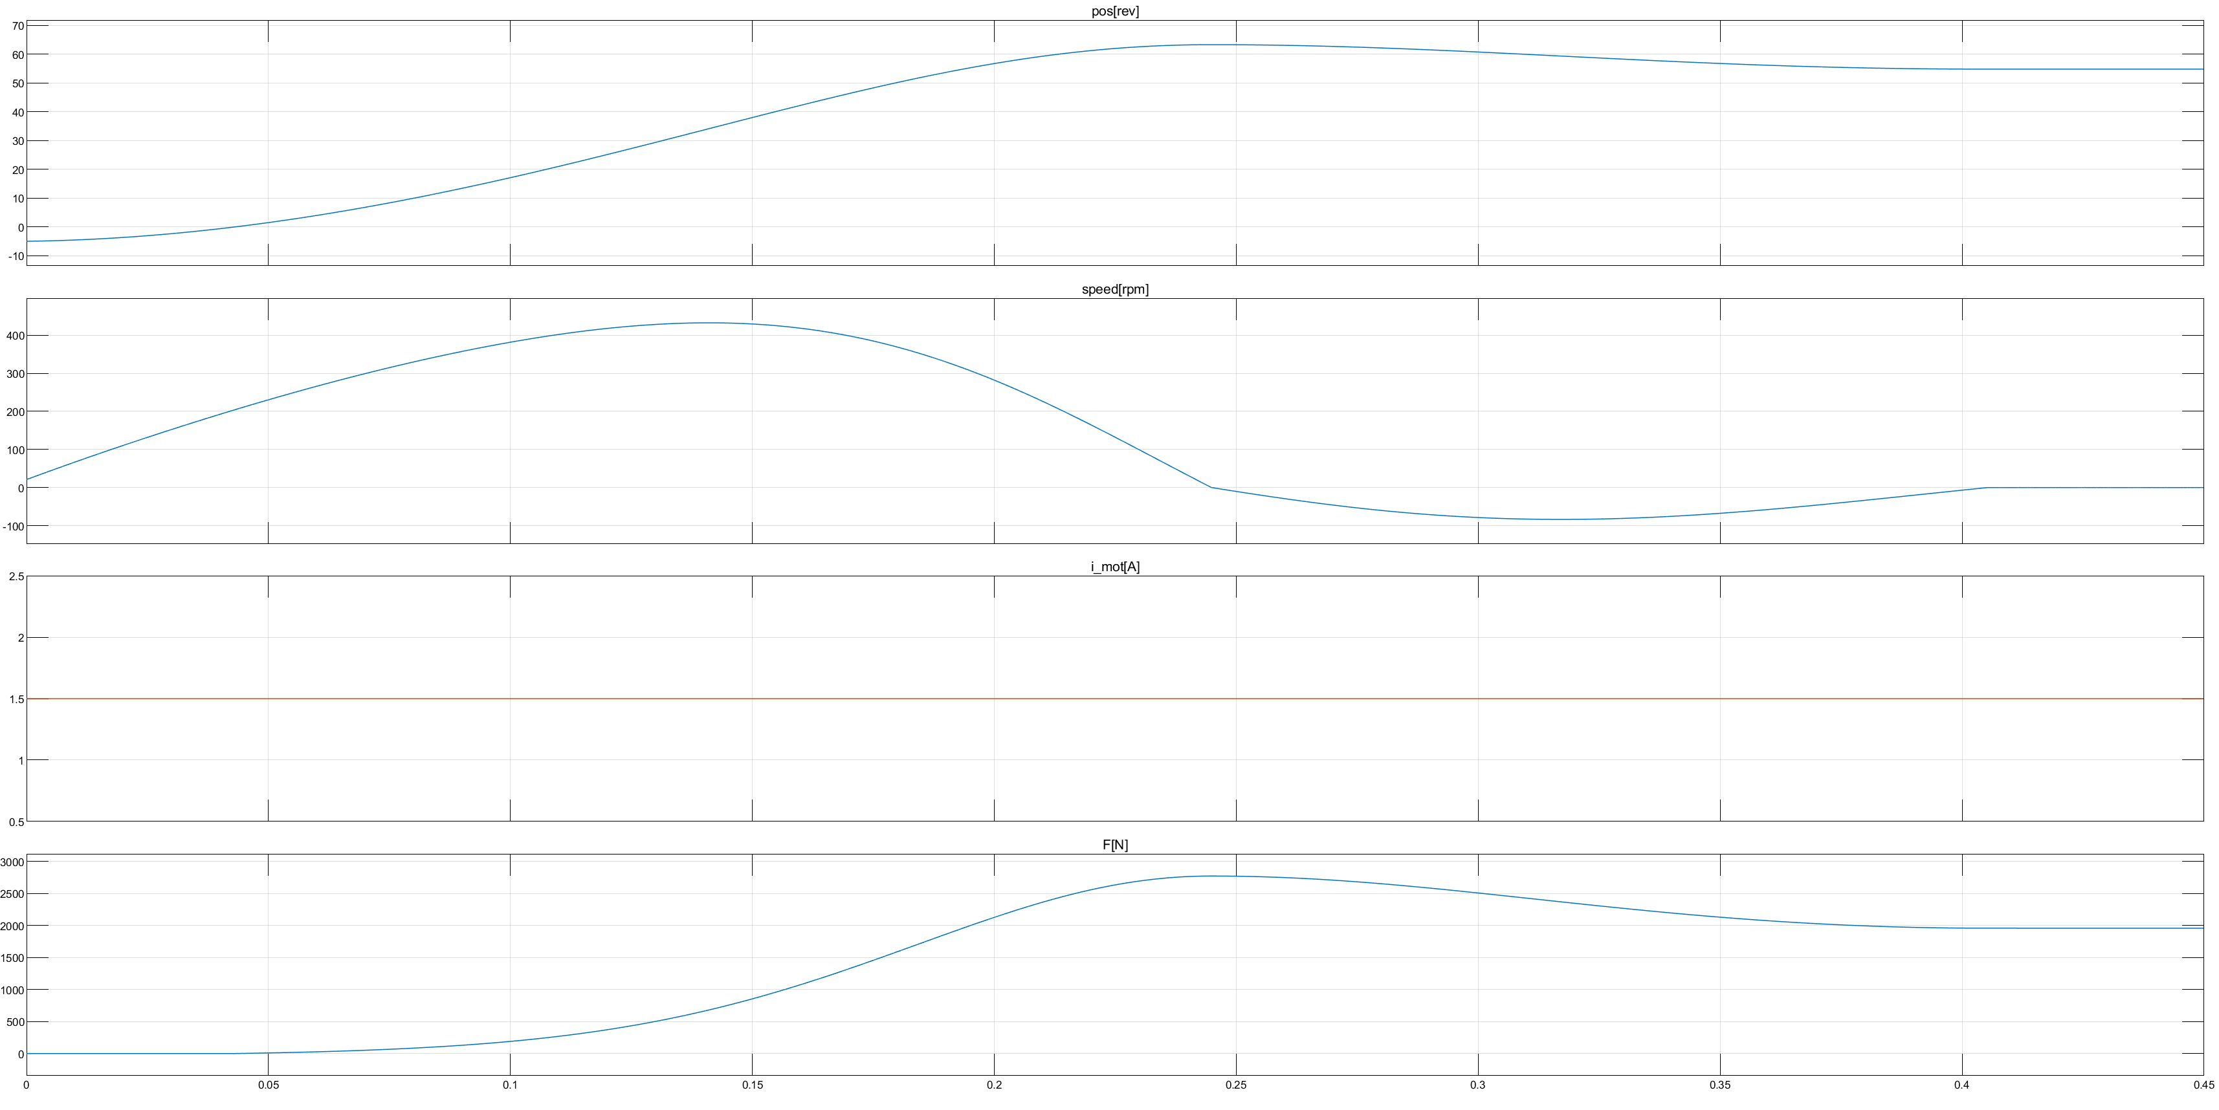

u= 1.5A, T = 0.35s
Calculation of the FI matrix
The behavior of the EMB model is similar, but the det(M) always zero.
Because x1 > epsilon, no sensitivitiy $\frac{∂y}{∂T_{s}}$ could be obtained.

Slide 6
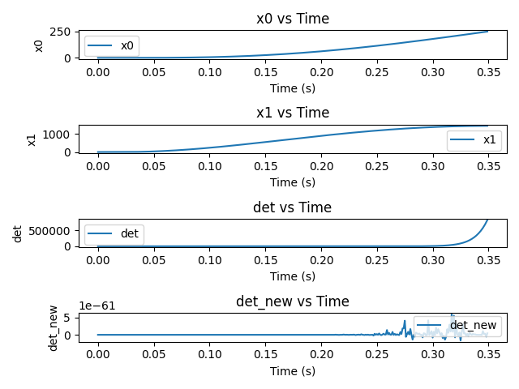
u= 2t, T = 0.35s
Calculation of the FI matrix
Reward function?

Slide 7
Next
Reward could be calculated by at least every 5 step, because dim(M) = 5, for step < 5 can’t tell enough information.
Use pytorch\Tensorflow to calculate the Jacobian automatically.
Test Jacobian by giving random x0 and random v, Finite diff check
Storage each 5 sensitivities and figure out the relationship
Read the new paper about the Trajectory Synthesis for Fisher Information Maximization

